Slide 1
Sales Insights

Slide 2
Reasons for Azure
Azure Data Lake Storage is the preferred choice for this scenario due to the following reasons:
Scalability
Performance
Cost-effectiveness
Integration with Power BI

Slide 3
Flow of the Procedure
Data Extraction
Data Transformation
Data Loading
Data Visualization

Slide 4
Categories of fields
Customer:
Customer Name
Credit Card Number
Country
Location
Phone Number
Order ID
Product:
Product Name
Expiry Date
Date of Sold
Price
Store
Store code
Quantity

Slide 5
Gained Insights
Sum of price by location: Mumbai is maximum
Count of expiry date: 2020 is maximum
Maximum ordered Location: Houston
Maximum Ordered product: Laptop
Maximum CreditCardNumber usage: USA
Maximum Products Ordered month: January
Maximum Store code count by location: Houston
The Shopping decreased from 2020 to 2023.
Maximum Ordered Country: USA

Slide 6
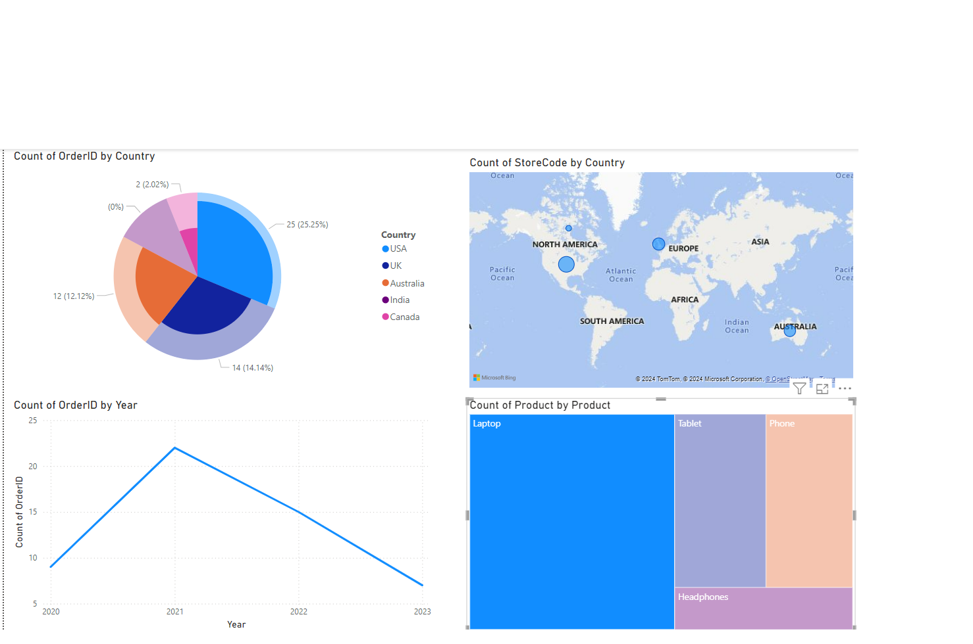
Insights

Slide 7
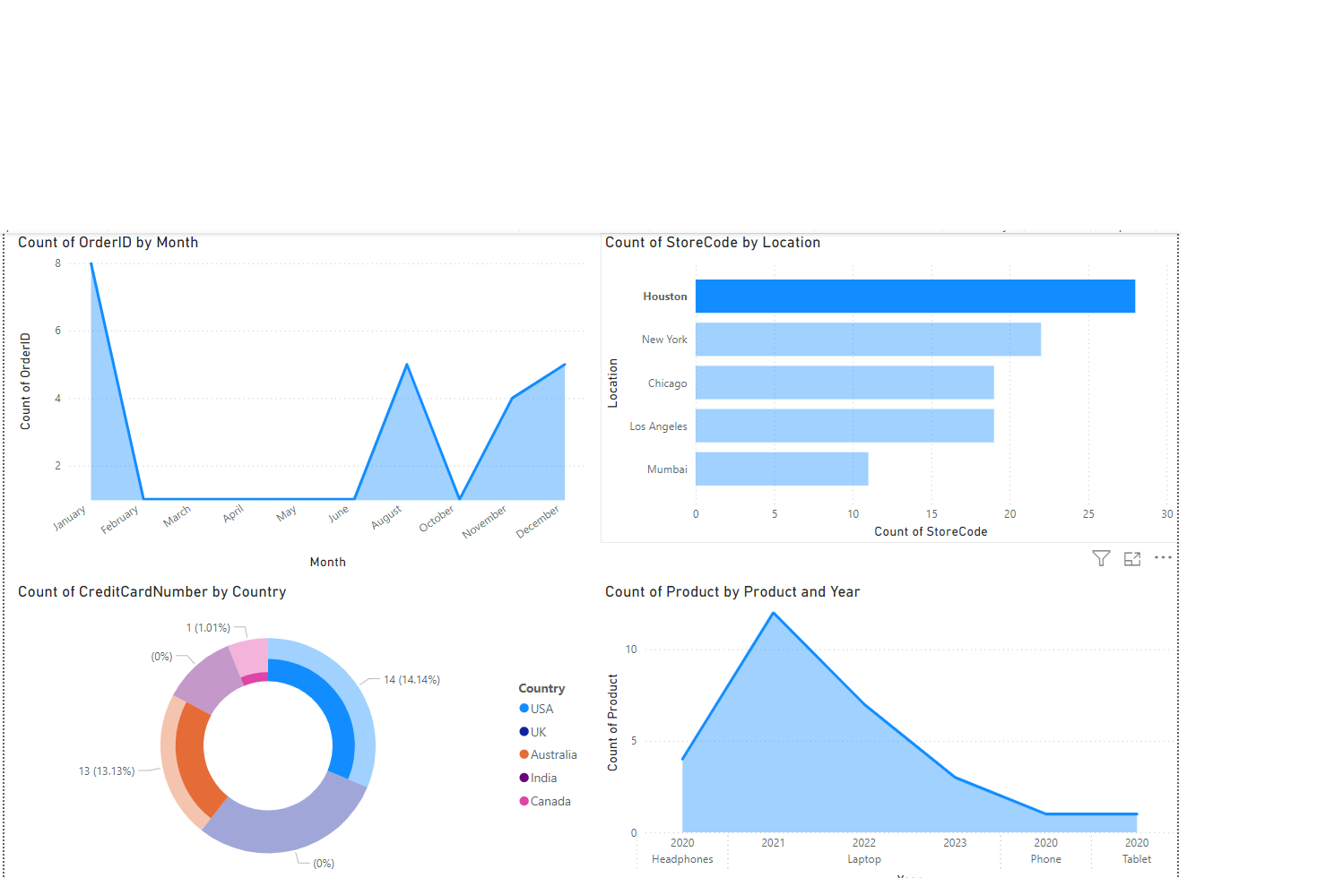
Insights

Slide 8
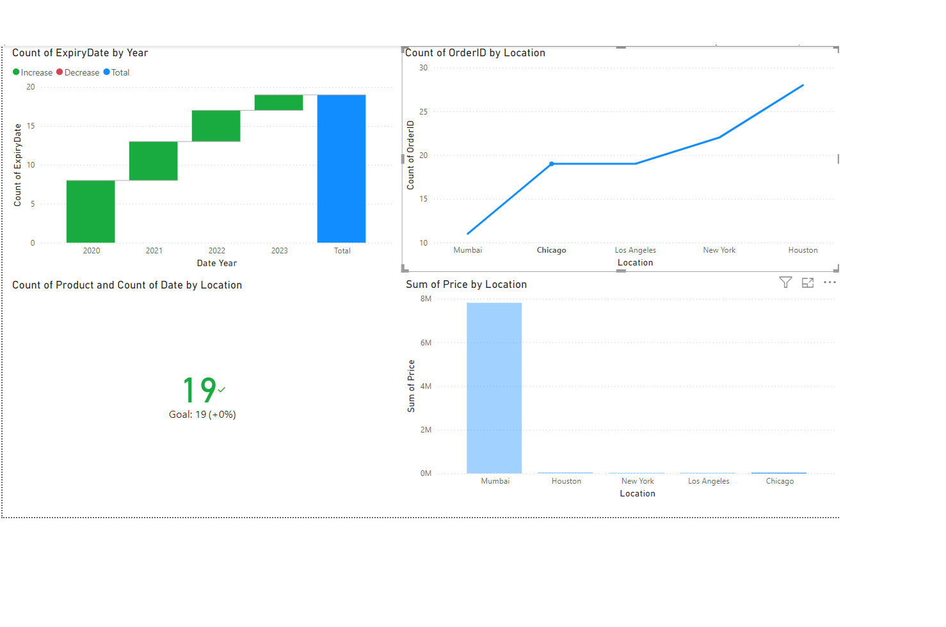
Insights

